Slide 1
糖尿病视网膜病变 (diabetic retinopathy, DR)
Dr. Shen Qin
Associate Consultant
Pharma Insights

Slide 2
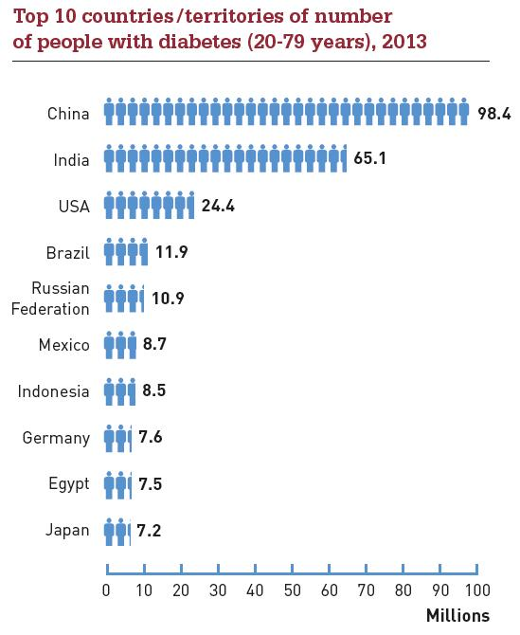
Foreword
据IDF统计，2013年全球糖尿病患病人数为3.82亿；
估计到2035年，全球将有近5.92亿人患糖尿病。
IDF公布的2013年全球糖尿病患者最多的10个国家，中国高居榜首（单位：百万）

Slide 3
Why it is important to understand DR?
Foreword
China
World
98 M
Diabetes
382 M
>32 M
Any type of DR
>126 M
>20M
>83 M
Vision-threating DR
“中国每年用于二型糖尿病治疗的费用目前已超过200 亿人民币，其中治疗糖尿病并发症的相关费用占80% 以上，平均每年每例有并发症患者的治疗费用为18828 元，是无并发症患者的5.1 倍。”
——KOL，中华医学会糖尿病分会成员，北京人民医院
Notes:
过去30 年，中国二型糖尿病患病人数持续上升，患病率从1980 年的0.67%上升为2008 年的9.7%，全国二型糖尿
病患病总人数为9240 万。未来10 年，患病率预计保持稳定，中国二型糖尿患病人群会随着人口的增长而继续增长，预计
2021 年增长至1 亿522 万。由于大部分病人未被诊断出而处于不知晓状态，中国目前二型糖尿病医院就诊率只有40%；对于二型糖尿病的诊断不存
二型糖尿病初治病人的治疗分为初治阶段和维持治疗阶段。初治阶段基本在三甲医院确定初治方案，并经历1 至3 个月观察与调整。一旦方案稳定，即进入维持治疗阶段。初治阶段，80% 的病人在内分泌科就诊；维持治疗阶段，会有部分的病人分流到其他科室治疗并发症。根据KOL 的访谈发现，医生按照空腹血糖 (FBG)=10mmol/L 和身体质量指数
(BMI)=24kg/m2 两个指标，把病人分为四
大类：1）血糖高体重正常；2）血糖高体
重超重；3）血糖超高体重正常；4）血糖
超高体重超重。1）类病人最多，4）类病
人最少。未来10 年，中国人群体重超重
人群比例处于上升趋势，导致 2）和 4）
类病人比例会继续上升。
二型糖尿病本身极少导致死亡事件，
病人死亡主要是二型糖尿病的并发症所
致。并发症主要有心血管病、脑血管病、
糖尿病肾病、视网膜病变和糖尿病足。血
糖不达标，并发症风险大大上升。中国目
前血糖达标率远低于西方发达国家（美国
~50%，加拿大~60%），仅在20~30%。
根据KOL 估计，未来10 年，中国二型糖
尿病血糖达标率会上升到~45%，这主要受
益于病人教育的开展及专业医生队伍的扩
大。未来10 年，中国二型糖尿病并发症患
病率会因之下降。IMS 预计，未来
10 年就诊率将增长为60%，推动接受治
疗人数上升至6313 万人。

Slide 4
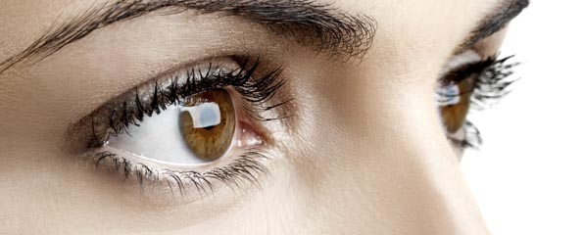
Topics
Diabetic Retinopathy Basics
Available treatments and unmet needs
Molecular pathogenesis and potential drug interventions

Slide 5
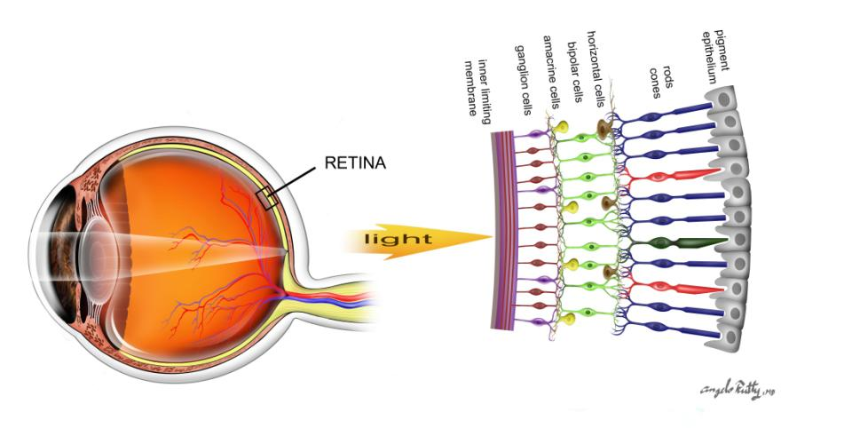
Anatomy of the Eye
The retina（视网膜） – senses light & transmits images to the brain
The macula（黄斑） – central part of the retina used to read and see fine details clearly
The vitreous（玻璃体） – clear gel fills the back of the eye and sits in front of the retina
视网膜
黄斑
Figure 1: The human eye
Notes:
视网膜：眼球最内层的薄膜。人体视网膜上有感光细胞，能感受光的刺激，转变为神经冲动，通过视神经传达至脑，形成视觉。
黄斑：视网膜的后极部有一直径为2mm的浅漏斗状的小凹区，称为黄斑（macula lutea ）是视网膜视觉最敏锐的部位。视锥细胞主要集中于此。
玻璃体：为无色透明胶状体玻璃体 位于晶状体后面，充满于晶状体与视网膜之间，充满晶状体后面的空腔里，具有屈光、固定视网膜的作用。

Slide 6
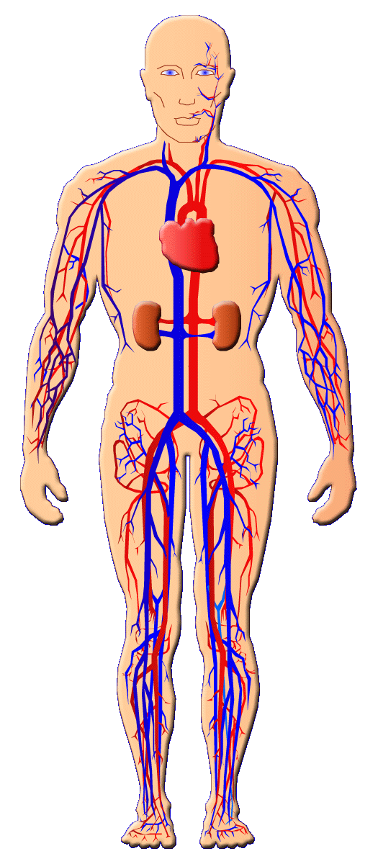
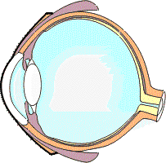
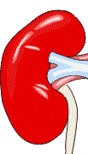
What Is Diabetic Retinopathy?
糖尿病视网膜病变 (diabetic retinopathy)
————One of the major diabetic complications
导致壮年失明
的主要原因
Diabetic neuropathy
糖尿病神经病变
导致非创伤性下肢
截肢的主要原因
Diabetic Nephropathy
(糖尿病肾病)
导致终末期肾病
的主要原因
Notes:
糖尿病并发症主要影响的是眼睛、肾脏和神经。
失明的糖尿病患者中85％左右是由DR引起。
Diabetes mellitus is associated with a wide variety of chronic diseases that
result from vascular complications throughout the body.

Slide 7
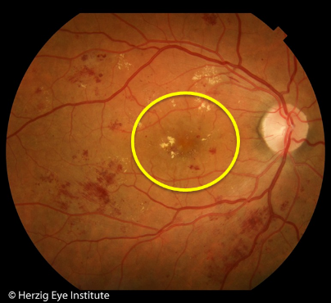
What Is Diabetic Retinopathy?
Occurs when elevated blood sugar levels cause blood vessels in the eye to swell and leak into the retina.
Diabetic macula edema (swelling of the retina)
Notes:
视网膜毛细血管的病变表现微动脉瘤、出血斑点、硬性渗出、棉绒斑、静脉串珠状、视网膜内微讯管异常（IRMA），以及黄斑水肿等。广泛缺血会引起视网膜或视盘的新生血管、视网膜前出血、体积血及牵拉性视网膜脱离。患者有严重的视力障碍。

Slide 8
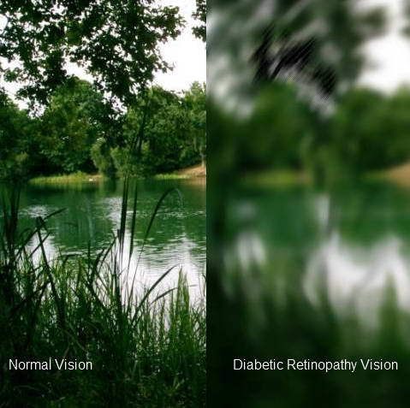
Signs and Symptoms
Normal Vision
Floaters
Blurred vision
Blank or dark areas in field of vision
Poor night vision
Vision loss
How vision may be affected by diabetic retinopathy
Notes:
糖尿病视网膜病变的早期可以没有症状，仅仅有部分的暗视力下降
当黄斑区水肿时，出现视物模糊，就会像左边这个图一样,照镜子时候，镜面沾满水的感觉，雾里看花。
当视网膜上有新生血管的形成，新生血管出血时，就会出现黑影漂浮物，黑色斑块，甚至可能出现失明，很像小时候用胶片照相的时候，胶片发霉了，成像后一块一块发霉的污点污染相片的感觉。

Slide 9
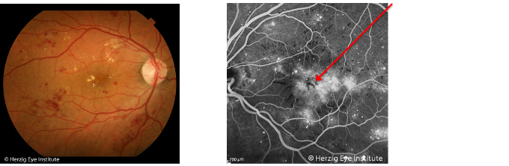
Types of Diabetic Retinopathy
Early stages:
Non-proliferative diabetic retinopathy (非增殖性糖尿病性视网膜病变）
Damaged blood vessels in the retina begin to leak fluid and small amounts of blood and cholesterol. （损伤血管渗出少量血液和胆固醇）
Mild NPDR may not necessarily affect vision.
Fluorescein dye leaking in macula
Results of blurred vision:
Macula edema
Fluorescein angiogram
of macular edema
Notes:
早期的糖网症因为还没有新生血管形成，称为非增殖性糖尿病性视网膜病变（NPDR），或背景型糖网症。

Slide 10
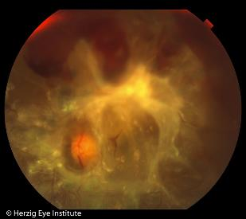
Types of Diabetic Retinopathy
Late stages:
Proliferative diabetic retinopathy (增殖性视网膜病变)
Hypoxia(缺血缺氧）
The retina responds by growing new abnormal vessels.
Can affect central & peripheral vision.
Vitreous hemorrhage (玻璃体出血） New blood vessels bleed into vitreous cavity.
Tractional retinal detachment （牵引性视网膜脱落） Scar tissue can shrink causing the retina to
detach and result in vision loss. More severe
vision loss occurs if the macula is detached.
Tractional retinal detachment
Notes:
有视网膜新生血管形成的糖尿病性视网膜病变称为增殖性糖尿病性视网膜病变（PDR），与单纯型视网膜病变相比，增殖性视网膜病变对视力的危害性更大，其可导致严重视力下降甚至完全失明。
可于DRP的任何阶段发生。DME是影响视力的主要原因。对其诊断主要依赖于裂隙灯活体显微镜加接触镜检查。虽然光学相干断层成像（optical coherence tomography, OCT）能直观地检测，但需要有设备，一般的眼科门诊是不具备的。DME的主要表现有：视网膜增厚，可表现为局部的或弥漫性的；有或无硬性渗出；以及囊样水肿。因此，DME的分型主要也有两类：（1）局部，可有环形渗出；（2）弥漫性，常伴有囊样水肿。荧光素血管造影可评价血视网膜屏障的损害状况。毛细血管闭塞引起无灌注和缺血，以及毛细血管通透性增加引起渗漏，是黄斑水肿形成的两个主要原因。

Slide 11
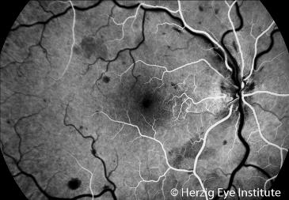
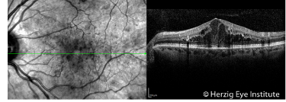
Diagnostic Tests
Basic assessment
Visual acuity test（视力）
Tonometry（眼压）
Blood glucose （血糖）
Advanced assessment
Fluorescein angiogram（眼底荧光血管造影）: dye is injected systemically which
demonstrates retinal circulation
Fluorescein angiogram
Optical coherence tomography
(光学相干断层成像）：non-invasive imaging study that reveals retinal anatomy
Optical coherence tomography (OCT)
Notes:
.血糖检查
定期测定血糖水平监控糖尿病病情发展。
2.肾功能检查
及时发现糖尿病肾病并发证。
4.眼底荧光血管造影
如在眼底镜下尚未发现糖尿病性视网膜病变时，眼底荧光血管造影就可出现异常荧光形态。在眼底荧光血管造影下发现的微血管瘤比眼底镜下所见要早，要多得多。其他如毛细血管扩张，通透性增加，无灌注区，动静脉异常，渗出及出血，新生血管等，眼底荧光血管造影都有特殊表现。

Slide 12
Topics
Diabetic Retinopathy Basics
Available treatments and unmet needs
Molecular pathogenesis and potential drug interventions

Slide 13
Development of DR
————you have enough time-window to do something
－－First Diagnosed： 20％
－－10 years after diagnosed： 40－50％
－－15 years after diagnosed：
T1D（1型糖尿病）： 98％
T2D（2型糖尿病）： 78％
Notes:
1. 病因治疗：治疗糖尿病，严格控制血糖水平。
2.激光治疗：单纯型伴无灌注区及视网膜新生血管，考虑行视网膜激光光凝术；伴长期黄斑囊样水肿者，行黄斑区格子状光凝；增殖期行广泛或全视网膜光凝。
3.手术治疗：玻璃体积血、视网膜新生血管形成伴牵拉性视网膜脱离者，行玻璃体切割术及眼内激光光凝术治疗。

Slide 14
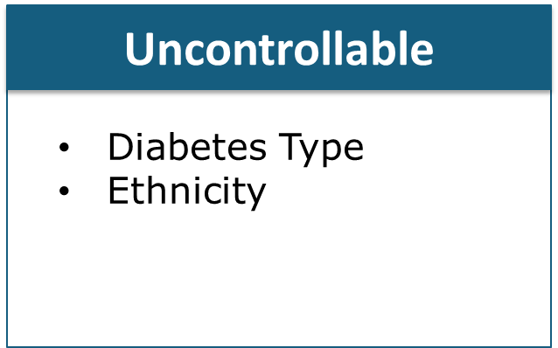
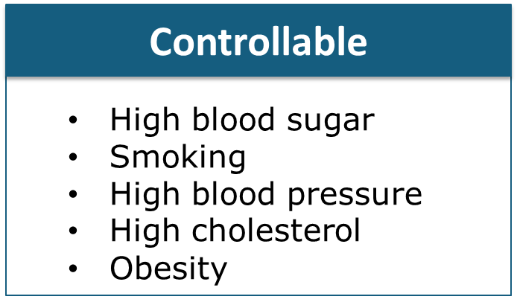
Prevention
High blood sugar
Diabetes type
Smoking
Ethinicity
High blood pressure
High cholesterol
Obesity
Early detection via eye exams is paramount
Type 1 diabetes: within 5 years of diagnosis, then annually
Type 2 diabetes: at time of diagnosis, then annually
Gestational diabetes: within 1st trimester
Notes:
严格控制血糖是减低DRP和DME的发病危险和进展的最基本治疗措施
1、控制引起DR的危险因素
（1）血糖达标－“五驾马车”
（2）血压达标－ACEI类、ARB类，CCB类等
（3）调脂治疗－他汀类等
（4）改善血粘度－阿司匹林等
2、定期检查眼底、视力，最好半年一次

Slide 15
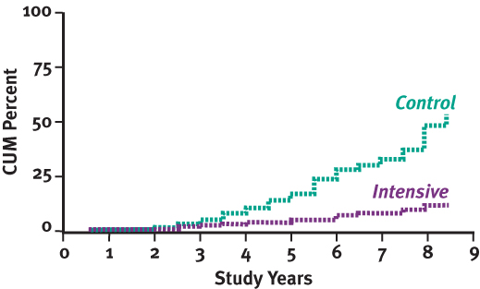
DCCT: NO BASELINE RETINOPATHY
Prevention
Systemic Controls

Slide 16
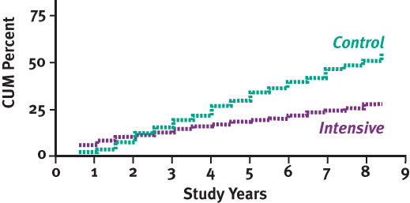
DCCT: MILD TO MODERATE RETINOPATHY
Prevention
Systemic Controls

Slide 17
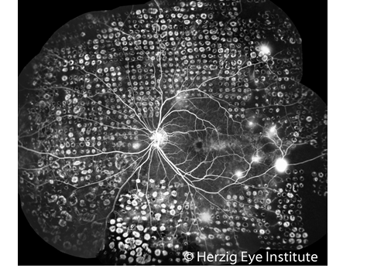
Treatments
Proliferative retinopathy
Laser surgery
Microscopic thermal laser burns
are made in the retina
Shrinks and prevents abnormal new
blood vessel growth, and stops leaking of blood vessels
Can reduce risk of further vision loss by 50%
Also recommended to treat macular edema
Figure 10: Laser photocoagulation

Slide 18
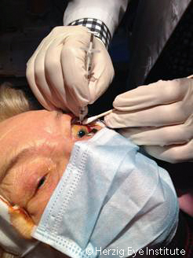
Treatments
Proliferative retinopathy
Intraocular (anti-VEGF) injections
Reduces swelling in the retina and causes abnormal vessels to regress
Figure 11: Intraocular injection

Slide 19
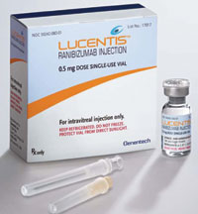
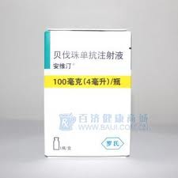
Treatments
Lucentis (兰尼单抗) ——anti-VEGF-A
0.5mg injection monthly or 2mg per 3 months （1200元/2mg)
Cost-effective than laser monotherapy
Avastin（贝伐单抗）——anti-VEGF
100mg：1300元/盒，400mg：5000元/盒

Slide 20
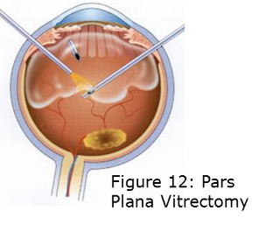
Treatments
Advanced proliferative retinopathy
Vitrectomy
Cloudy vitreous is removed and replaced with a clear solution
that mimics the normal eye fluids
Allows light rays to focus on the retina again
Pars plana vitrectomy

Slide 21
Topics
Diabetic Retinopathy Basics
Available treatments and unmet needs
Molecular pathogenesis and potential drug interventions

Slide 22
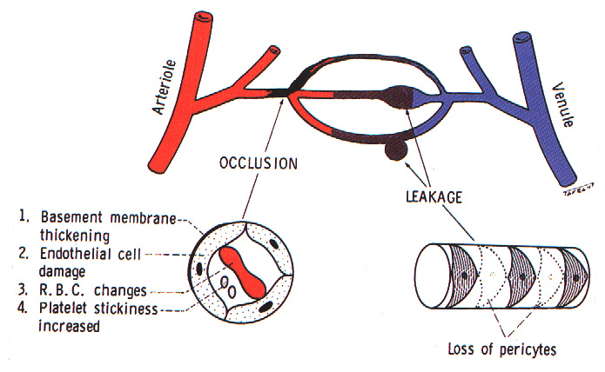
PATHOGENESIS
Notes:
二型糖尿病是由胰岛β 细胞损伤导致的胰岛素分泌量不足和胰岛素靶器官对胰岛素敏感性降低而导致的糖代谢异常，从而引发的糖、蛋白质、脂肪代谢紊乱综合征，在临
床上以高血糖为主要特点，可引起神经及血管微循环改变。由于糖尿病患者血液成分的改变，而引起血管内皮细胞功能异常，使血-视网膜屏障受损。视网膜毛细血管内皮细胞色素上皮细胞间的联合被破坏，造成小血管的渗漏。糖尿病患者微血管病变主要的发生在视网膜及肾脏，是致盲、肾功能衰竭及死亡的主要原因。

Slide 23
Key Players in the DR pathogenesis
Gluco-TOX （糖代谢紊乱）
Oxidative stress（氧化应激）
Key signaling regulators （关键信号转导因子）
Cytokines （细胞因子）
Neurokines（神经生长因子）

Slide 24
Support cells
(1) Gluco-toxicity pathway fluxes ↑
ROS ↑
Acellular capillaries
Glucose ↑
Signaling pathway
（RAF/MAPK，PI3K/Akt/mTOR…)
Pericytes loss
Y
(2) Transcription of cytokines,
growth factors… ↑
Cytokines, Growth factors
Y
Y
=
RAS/RAF/MAPK；
JAK/STAT； PI3K/AKT ↑
ROS ↑
Ischemia ↑
=
Transcription of adhere molecules
Retinal endothelial cells
=
=
VCAM, Integrin
(4) Angiogenesis
leukocyte adhesion
(4) BRB breakdown
Notes:
Molecular pathogenesis in the development of diabetic retinopathy. (a) Hyperglycemia and other metabolic abnormalities lead to increased glucose consumption in the vascular support cells of the retina, which cause the gluco-toxicity. (b) These support cells, such as glia, microglia, and pericytes respond with increased ROS, cytokines and growth factors production. (c) Over-produced cytokines and growth factors are released to the retina, and bind to their receptors to regulate cell function resulting in endothelial cell death, pericyte loss, leukostasis and leakage. (d) Leukostasis and BRB leakage points increase and impair more areas of the retina, leading to severe BRB breakdown, macular edema, hypoxia due to enlarged vascular occlusion and non-perfusion areas, and ultimately the hypoxia- induced angiogenesis associated with PDR.

Slide 25
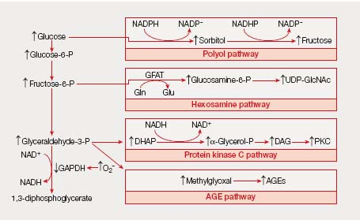
Gluco-TOX （糖代谢紊乱）
1、polyol pathway（多元醇途径的增加）
2、 AGEs/RAGE pathways（糖基化终末产物的形成增加)
3、 PKC(蛋白激酶C亚型的激活)
4、 hexosamine(己糖胺途径的增加)

Slide 26
Oxidative stress（氧化应激）
In the clinic, oxidative stress is found.
In diabetic animal models, suppression of ROS protects against the early development of DR.
In early-stage DR patients, oral administration of calcium dobe-silate (CDO) daily over two years, preventing and even reverting BRB disruption.
Notes:
Peter等发现：高糖条件下，视网膜周细胞和主动脉平滑肌细胞在氧化应激时，内皮细胞减少41％，周细胞减少25％¹。
应用SOD（超氧化物岐化酶）、α－生育酚等抗氧化剂后，可对氧化应激环境中的内皮细胞和周细胞起保护作用²。

Slide 27
Key signaling regulators （关键信号转导因子）
Oxidative-stress-induced cellular and vascular changes are mediated by oxidative modification of key signaling pathways such as(氧化修饰）:
PI3K/ AKT/mTOR
JAK/STAT
RAS/RAF/MAPK
In the clinic, these cascades were 60–80% more activated in the retinal microvessels of DR patients as compared with controls

Slide 28
Cytokines（细胞因子）
Cytokines up-regulation is initiated by Gluco-tox induced key regulators, and aggregated by hypoxia (缺氧）
DR related cytokines：
Fibroblast growth factor ， FGF（成纤维细胞生长因子）
Insulin-like growth factor 1 ，IGF-1（胰岛素样生长因子）
Vascular endothelial growth factor，VEGF（血管内皮生长因子）
Epidermal growth factor，EGF（上皮生长因子）
Transforming growth factors-β,TGF-β （转化生长因子）
Notes:
a variety of hyperglycemiainduced factors, including AGE/PKC/polyol/hexosamine pathway fluxes and ROS, stimulate transcription of proinflammatory mediators and growth factors in the retina via key signal transduction pathways,
The pathogenesis of DR is characterized by many features typical of inflammation. Clinically, proinflammatory cytokines, growth factors and adhesion molecules were found to be significantly higher in the vitreous at all stages of DR relative to healthy controls [43–45].
In the STZ-induced rat model of DR, the retinal expression of TNFa, IL-1b, VEGF, SDF-1 and CXCR-4 (receptor of SDF-1) increased gradually with the prolongation of the disease

Slide 29
Cytokines（细胞因子）
VEGF
Anti-VEGF therapy ：BRB leakage and angiogenesis
Launched： Ranibizumab (in 2011)
Under development：
Oligonucleotides (Pegaptanib)
Interfering RNA (Bevasiranib)
Polypeptides (Aflibercept)
Notes:
anti-VEGF therapy in promoting visual acuity through the inhibition of BRB leakage and angiogen-esis in DR patients [49]. Ranibizumab was launched (in 2011) for the condition of DME. Other not approved treatments targeting VEGF include oligonucleotides (Pegaptanib), interfering RNA (Bevasiranib), and polypeptides (Aflibercept).
TNFa
induces BRB leakage in a nuclear factor (NF)-kB dependent, VEGF-independent manner through its regulation of claudin 5 and ZO-1 mRNA and other protein expression [74]. In particular, IVT injection of bevacizumab potently diminishes VEGF and SDF- 1a, but not TNFa and interleukins (IL-1b, IL-6, IL-8) in the retina [75]. An independent role for TNFa in vascular leakage and BRB breakdown suggests the potential of anti-TNFa as monotherapy or combination treatment for patients refractory to anti-VEGF ther-apy alone, although this needs further confirmation in preclinical models.

Slide 30
Cytokines（细胞因子）
TNFa
Induces BRB leakage in a nuclear factor (NF)-kB dependent, VEGF-independent manner
IVT injection of bevacizumab potently diminishes VEGF, but not TNFa and interleukins (IL-1b, IL-6, IL-8) in the retina
Potential of anti-TNFa as monotherapy or combination treatment for patients refractory to anti-VEGF therapy alone
Notes:
Induces BRB leakage in a nuclear factor (NF)-kB dependent, VEGF-independent manner through its regulation of claudin 5 and ZO-1 mRNA and other protein expression [74]. In particular, IVT injection of bevacizumab potently diminishes VEGF and SDF- 1a, but not TNFa and interleukins (IL-1b, IL-6, IL-8) in the retina [75]. An independent role for TNFa in vascular leakage and BRB breakdown suggests the potential of anti-TNFa as monotherapy or combination treatment for patients refractory to anti-VEGF ther-apy alone, although this needs further confirmation in preclinical models.
Intravenous Infliximab (5 mg/kg) for diabetic macular edema refractory to laser photocoagulation improves visual acuity by 6.9 letters on week 16 (P = 0.017) [76]. However, IVT infliximab (1 mg or 2 mg) treatment has a significant risk of eliciting a severe intraocular inflammatory reaction [77]. Alt

Slide 31
Neurokines（神经生长因子）
Clinical findings：Even earlier than micro-vascular abnormalities
VEGF ↑
Glutamate↑
NMDA R,
Ca influx
Neuro-degeneration
Low Cost-effectiveness

Slide 32
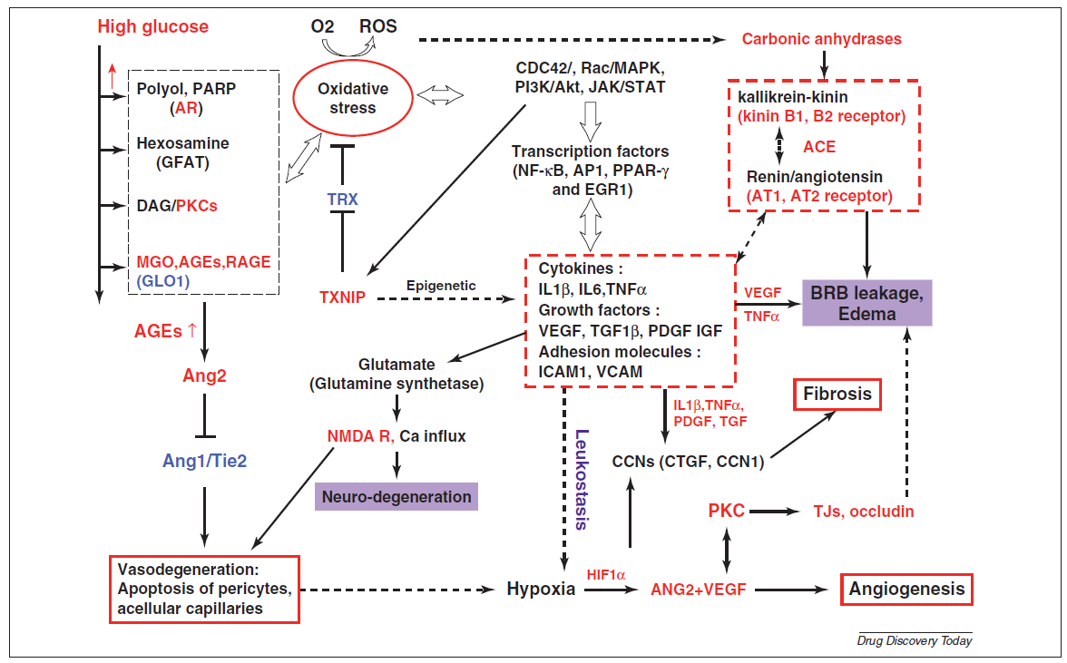

Slide 33
High glucose
Gluco-toxic pathway fluxes：
Polyol；PARP； Hexosamine ；DAG/PKCs；MGO,AGEs,RAGE
Intervention 3
Intervention 1
Key signaling pathways：
CDC42/，Rac/MAPK，
PI3K/Akt，JAK/STAT
Oxidative stress
Epigenetic modification
Transcription factors
kallikrein-kinin system
Adhesion molecules：ICAM1, VCAM
Cytokines：
IL1b，IL6,TNFa
Renin/angiotensin system
Intervention 5
Intervention 4
Growth hormones & factors：
VEGF，TGF1b,PDGF IGF
Intervention 2
Vaso-neuro degeneration
Intervention 6
Vising losing Angiogenesis & Fibrosis

Slide 34

Q&A Session

